Slide 1
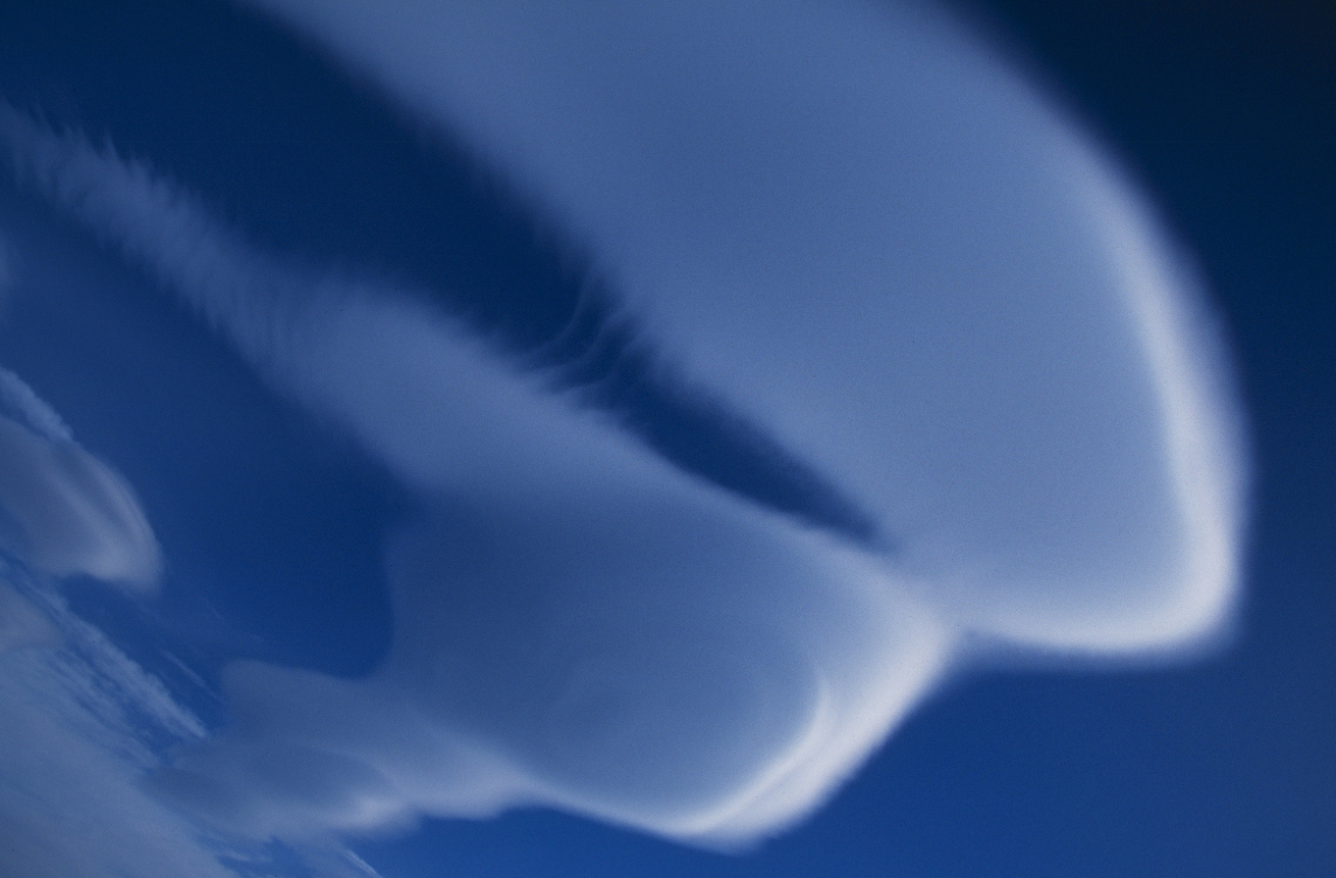
Heard Island
2000

Slide 2
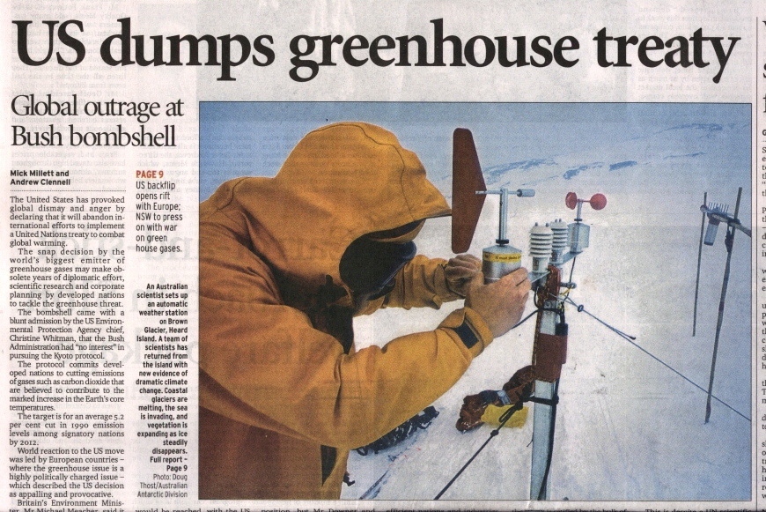
Sydney Morning Herald, March 30, 2001

Slide 3
Heard Island 2000
Study of the Brown Glacier
Introduction
Why the Brown Glacier?
What we did
Weather data & results
Herr Truffer … (the Australian Scientist)

Slide 4
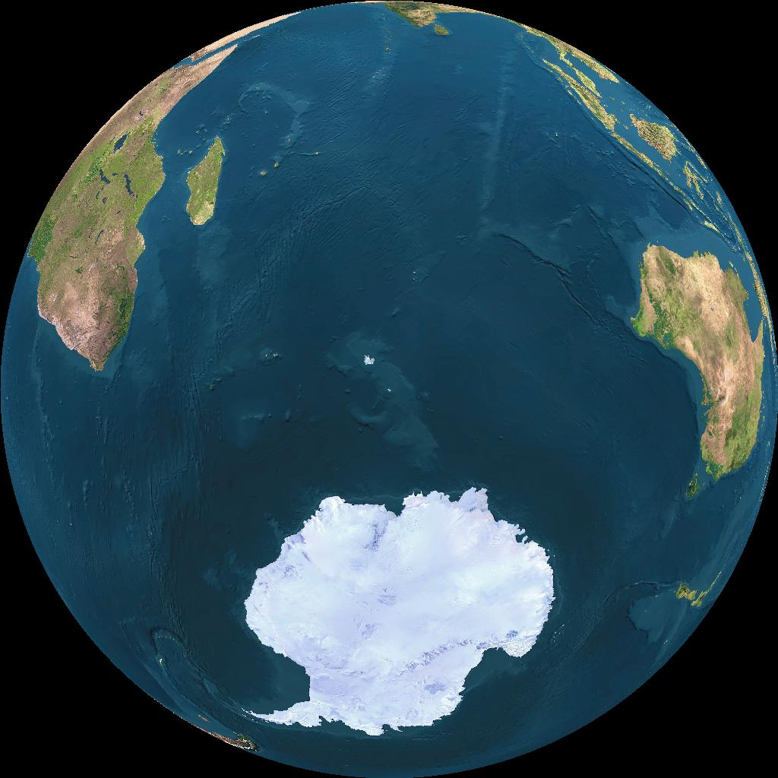
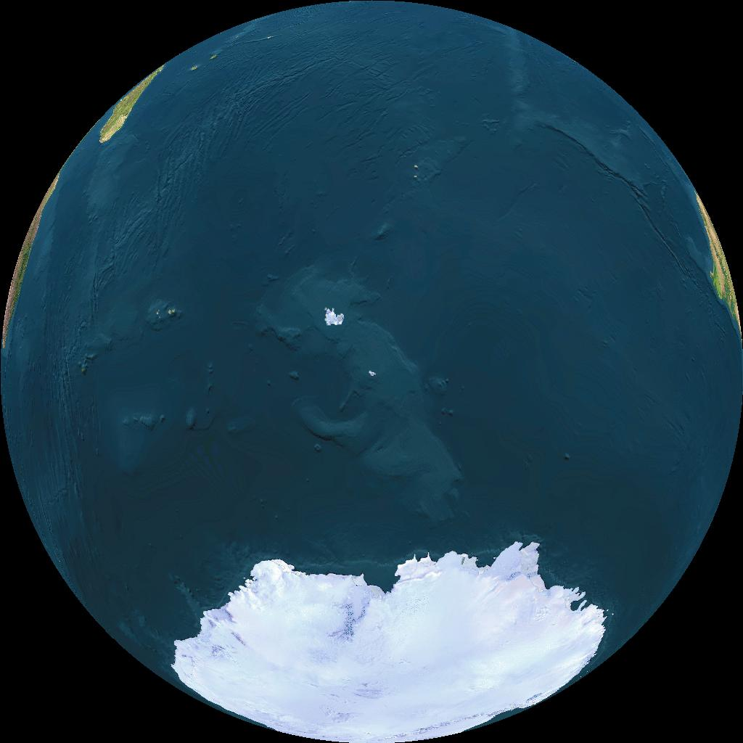
Heard Island 2000
Location
53 S
73.5 E
463
4122
1751

Slide 5
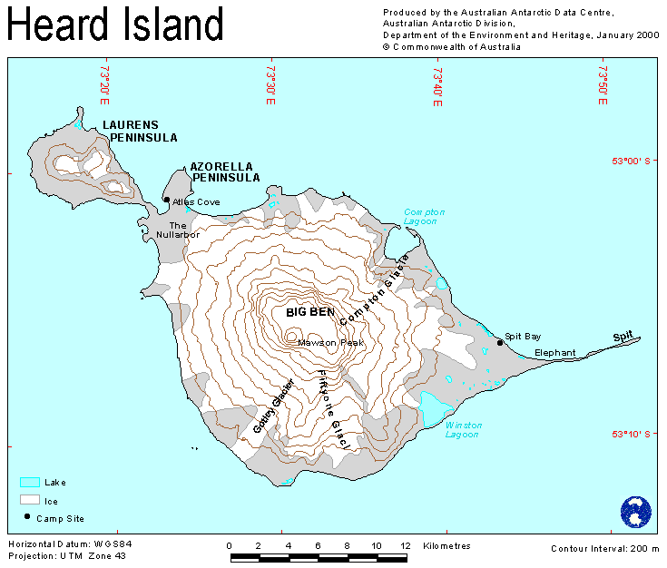
Heard Island 2000
Location

Slide 6
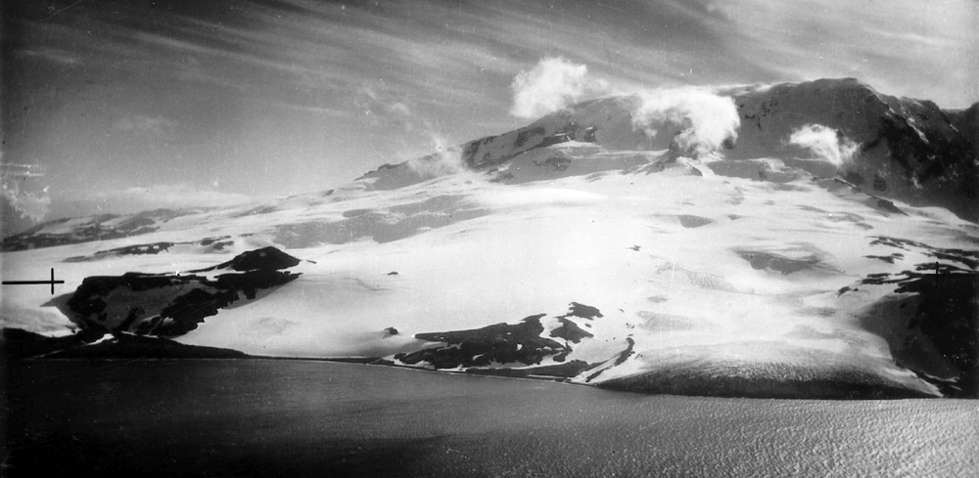
Scarlet Hill
Brown Glacier
Skua Beach
1947

Slide 7
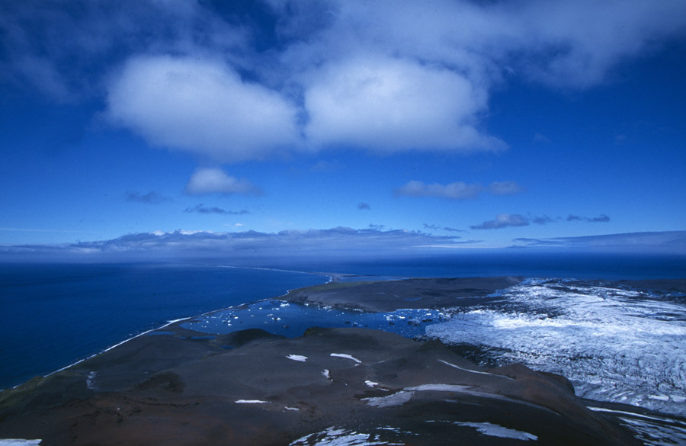
November 2000

Slide 8
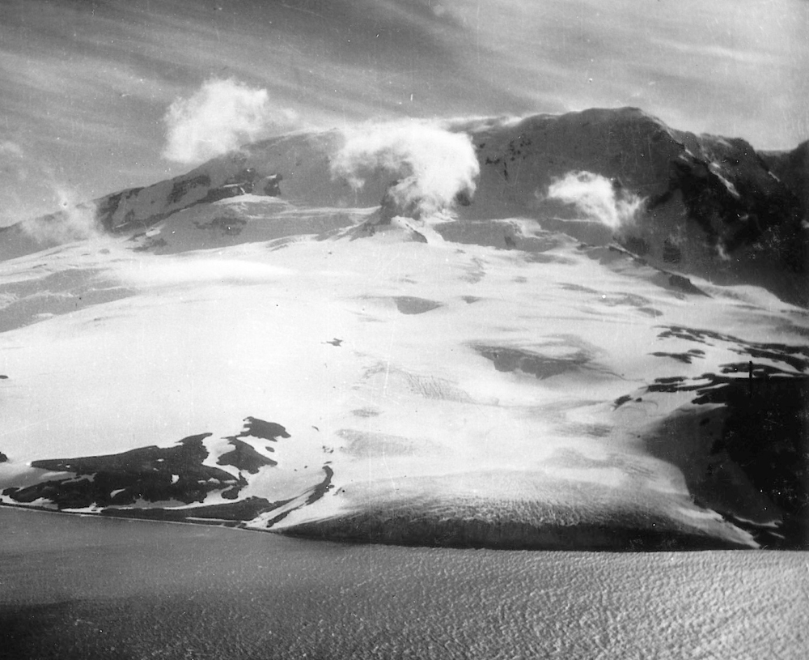
1947

Slide 9
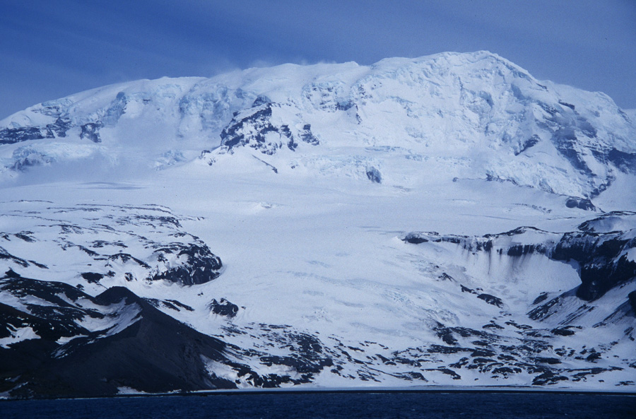
 BG05



Rock AWS


 BG35


 BG50
November 2000

Slide 10
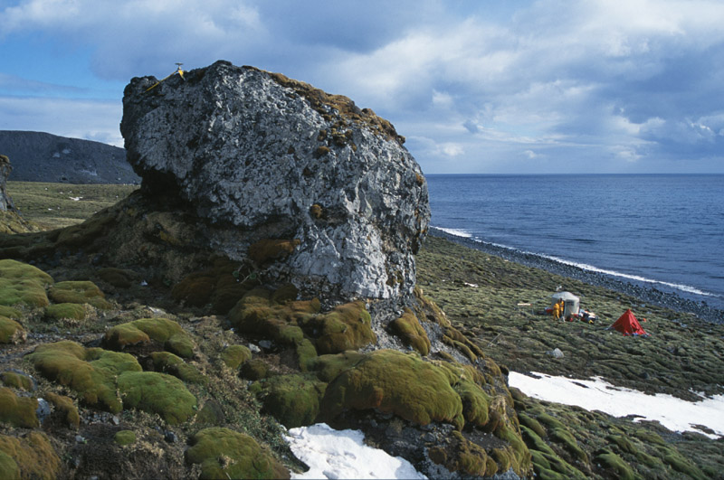

Slide 11
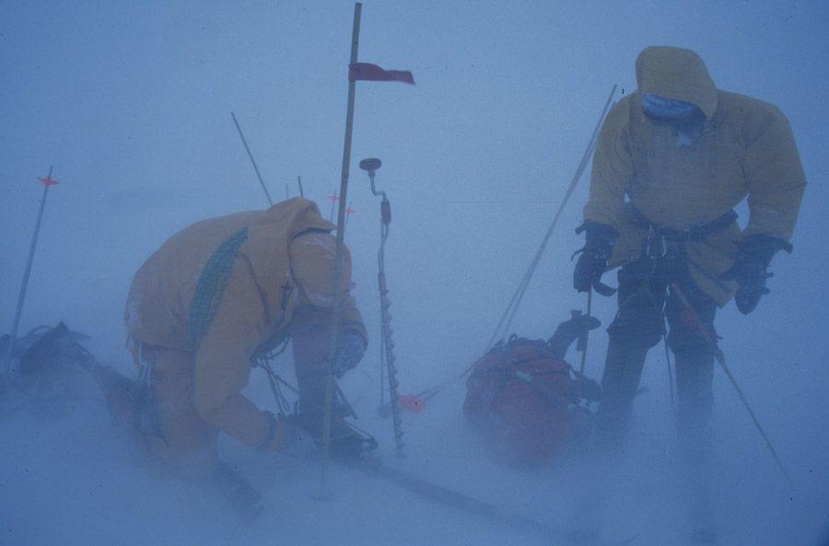

Slide 12
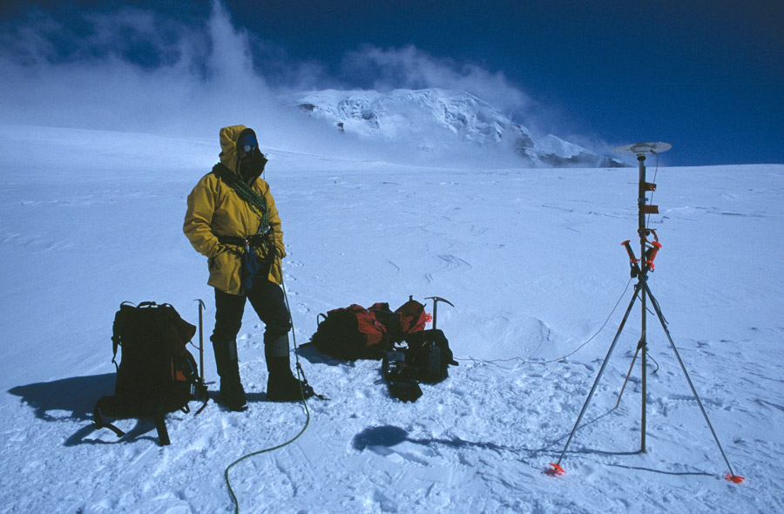

Slide 13
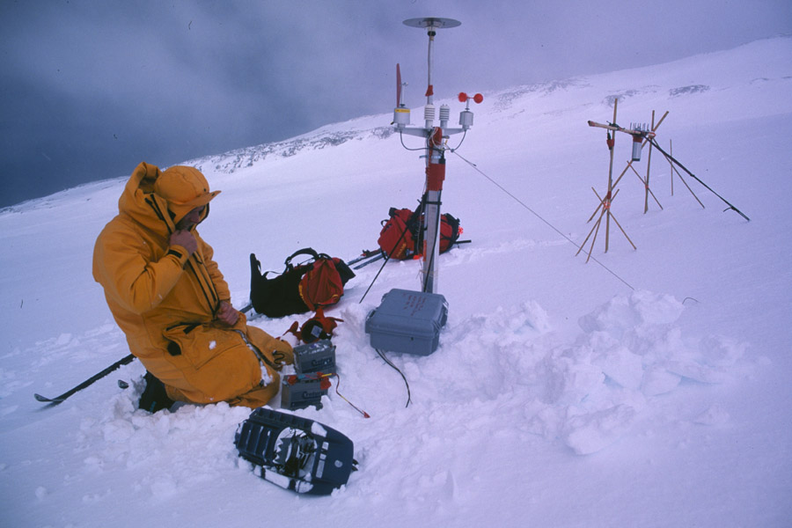

Slide 14
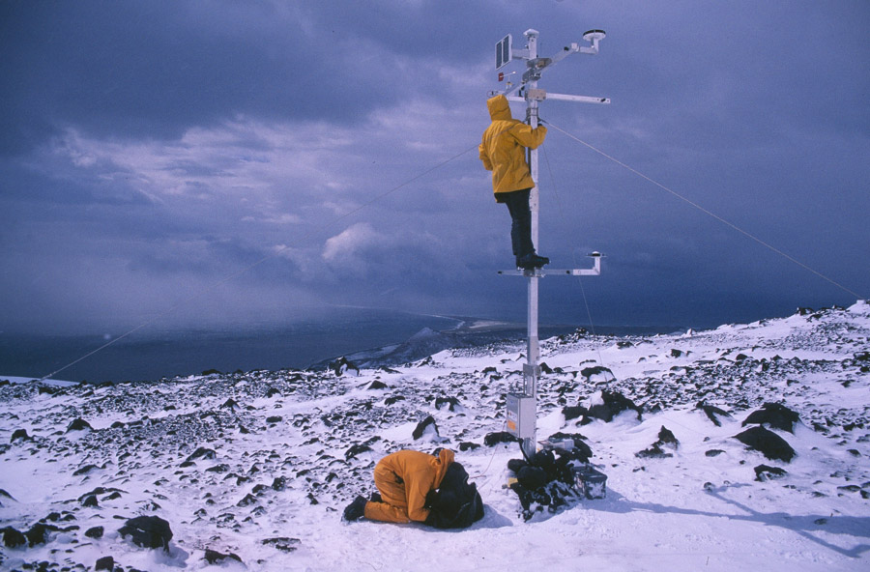

Slide 15
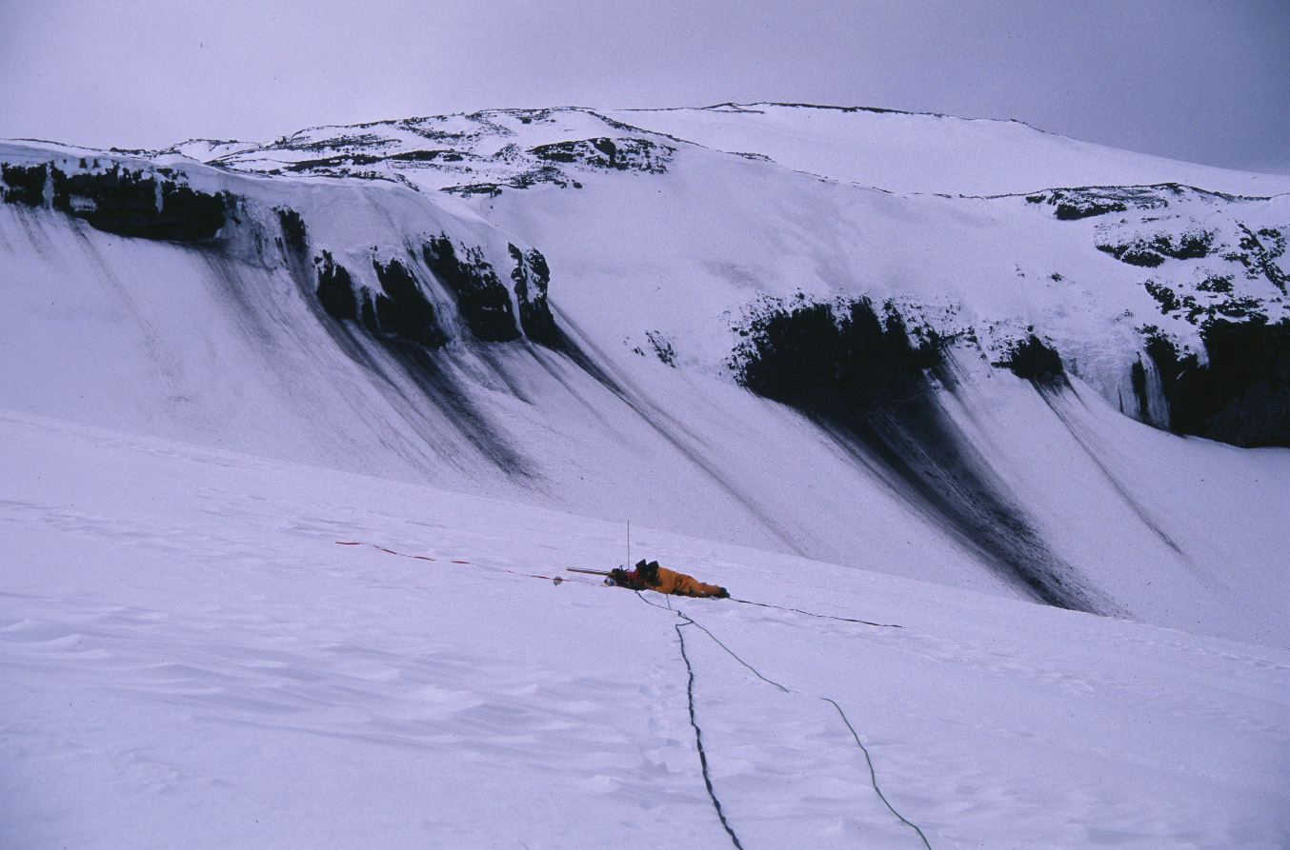

Slide 16
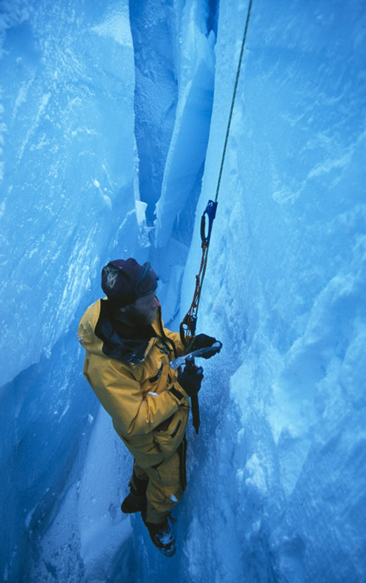

Slide 22
March 2.76 ºC/100a
Average 1.74 ºC/100a
August 0.64 ºC/100a

Slide 23
Lapse rate 0.72 ºC/100 m

Slide 24












Föhn Winds
33 hours >7 ºC
Rock AWS, 550m asl

Atlas Cove AWS, sea level

Slide 25
Rock AWS, 550m asl
Spit Bay AWS, sea level

Slide 26
Föhn Winds
strong, gusty, dry and warm winds which develop on the lee side of a mountain range when stable air is forced to flow over the barrier by the regional pressure gradient
Rises, loses moisture, cools at saturated adiabatic lapse rate (0.65 °C per 100 m)
Decends, warms at dry adiabatic lapse rate (1.0 °C per 100 m)
Heard Island e.g.: T difference as much as 13 °C at sea level after 2700 m
In many instances however, there may be no precipitation over the mountain, and in such cases the föhn effect is the result of standing wave motions forcing air from higher levels to descend (Barry & Chorley, 1976)

Slide 27
Föhn Winds

Slide 28
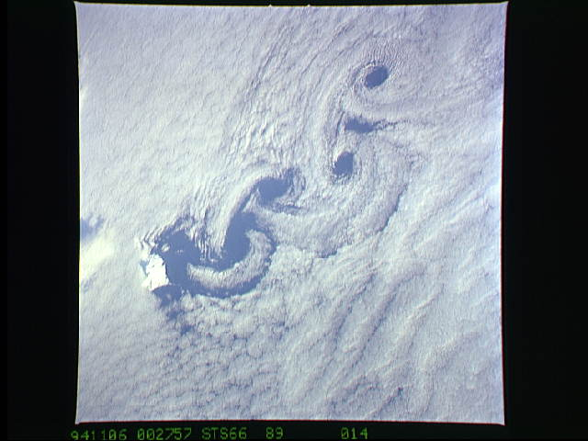
von Karmen Vortices

Slide 30
Precipitation
0.75 m snow fall, 25 days in November = 0.45 m water equivalent for November
Precipitation data from 1948-54 dataset shows Nov. precip. 7% annual total
Gives average water equivalent precipitation at BG35 of 6.20 m

Slide 32
Glacier morphology
Surveying of
Profiles on the glacier
Old moraines
lagoon shoreline
lagoon depth

Slide 33
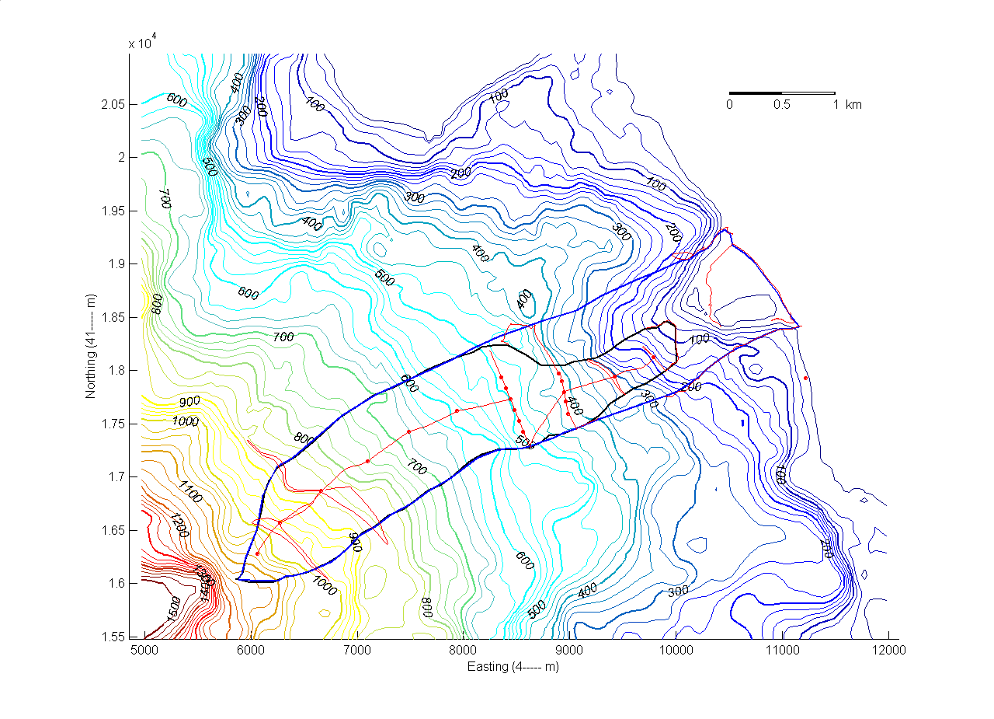

Slide 34
Area and volume change
Since 1947 Brown Glacier lost 1.6⋅10⁸ m³ (15%) of ice and reduced its area by 3.7⋅10⁶ m² (33%)
Average thickness change since 1947: -0.55 m a⁻¹

Slide 35
Comparison with Alaskan Glaciers
Brown Glacier

Slide 36
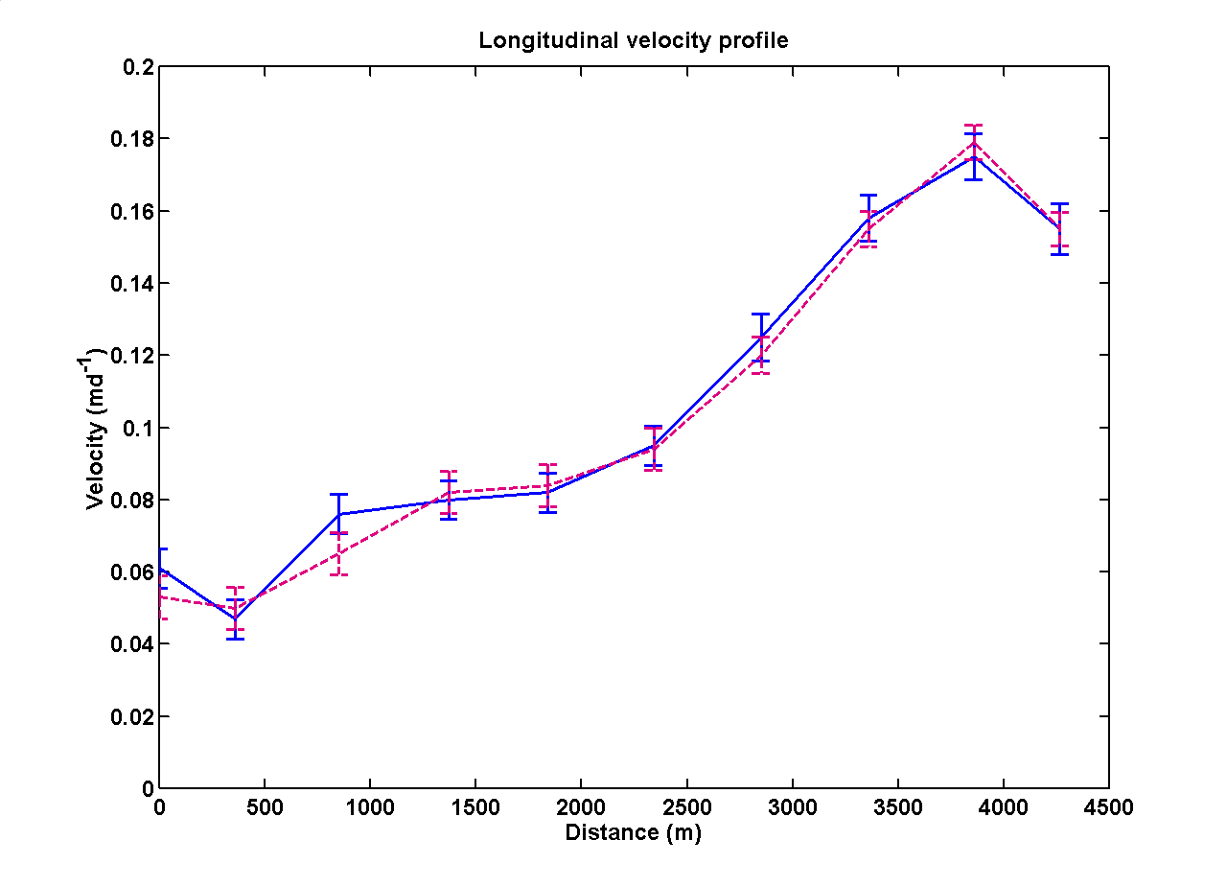
Glacier dynamics

Slide 37
Ice Flux

Slide 38
Ice Flux
Ice flux at BG35: 1.9⋅10⁶ m³a⁻¹
0.7 m a⁻¹ of average accumulation above BG35
2.0 m a⁻¹ of average ablation below BG35
BG35 is in the upper ablation area

Slide 39
Ice thickness
Measured at low elevations with a portable RES
Calculated by assuming no sliding at high elevations

Slide 40
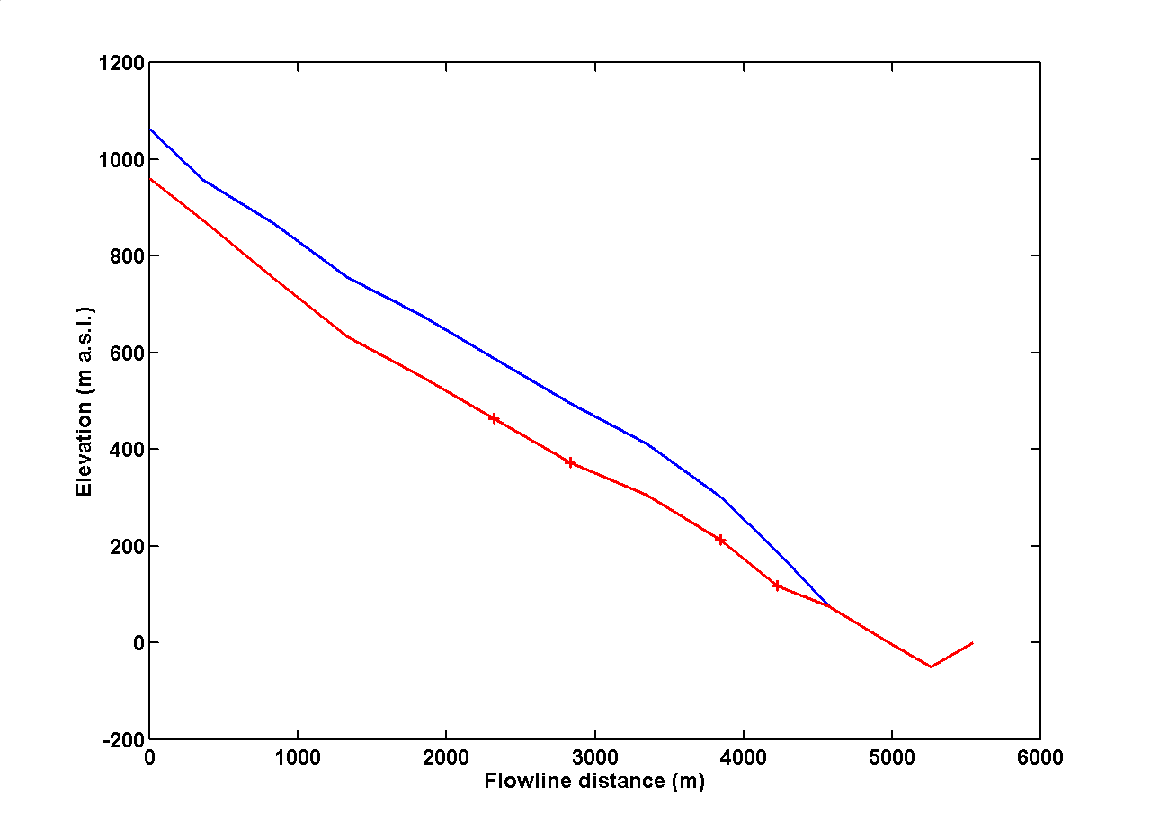
Ice thickness profile

Slide 41
Flux divergence and mass balance
q(x)
q(x+dx)

Slide 42
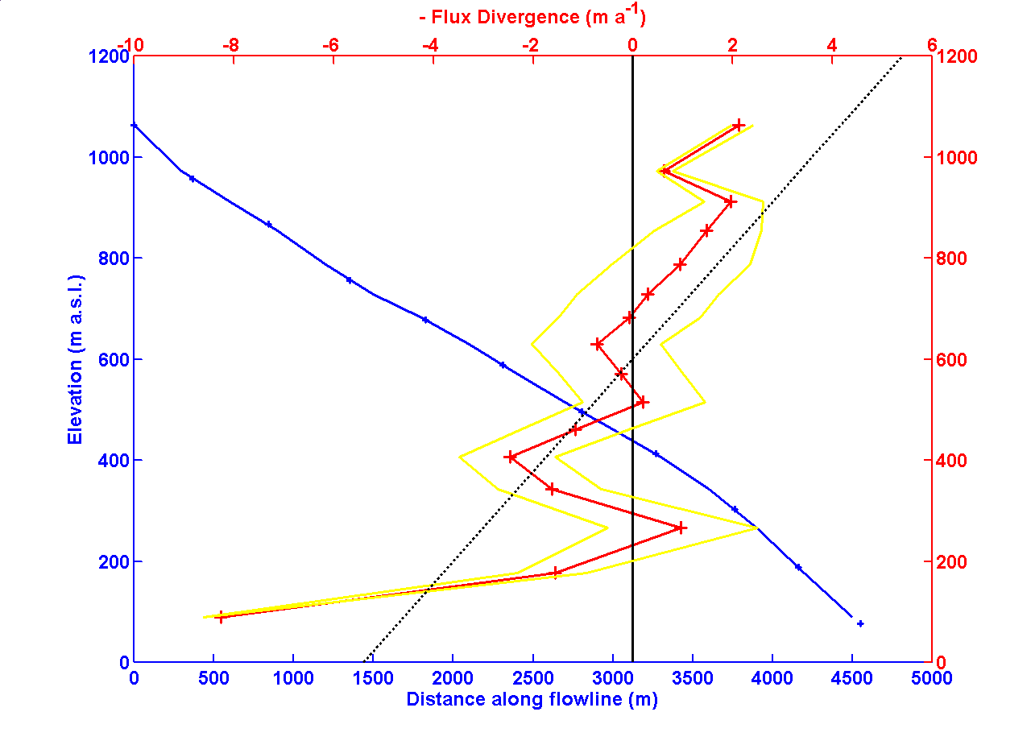

Slide 43
Conclusions
Variability of climate
0.8ºC warming in last 50 years
Glacier retreat of land terminating glaciers
Brown Glacier lost 15% of its volume and
33% of its area since 1947
Indications for current thickening at high
elevations and thinning at low elevations
This could be an effect of warming with
an increase in precipitation

Slide 44
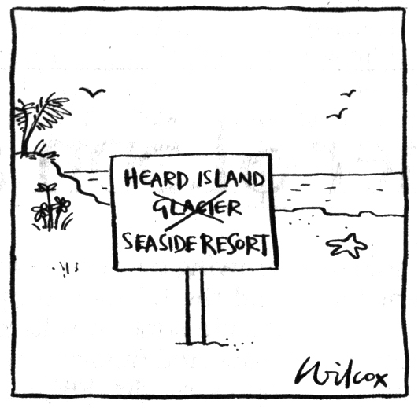

Slide 45
